Slide 1
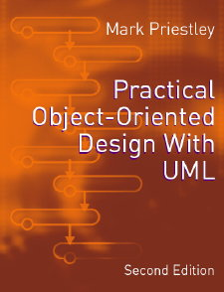
PRACTICAL
OBJECT-ORIENTED
DESIGN WITH UML
2e
Chapter 7:
Restaurant System: Implementation

Slide 2
Implementation
The process of converting design models into executable code
  explicit rules can be given for the implementation of many UML model elements
  so to some extent code generation can be performed automatically
In addition, UML has specific diagrams for illustrating physical properties of source code

Slide 3

Components
In UML, a component is a physical component of a system
For example, a file of source code
  this is distinct from the class it implements
  the relationship can be shown by a dependency

Slide 4
Component Diagrams
Show the components making up a system and the relationships between them
Relationships are shown as dependencies
  often to show when one component uses the facilities provided by another
Components can be grouped in packages

Slide 5
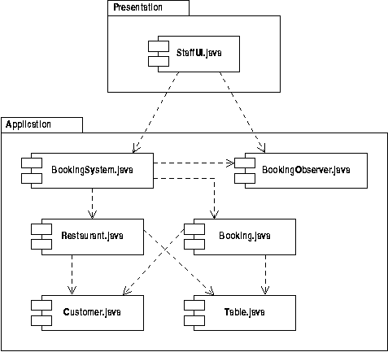
Booking System

Slide 6
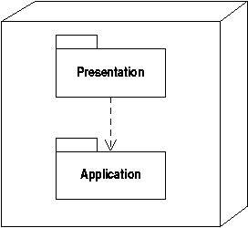
Deployment Diagrams
Show how components are mapped to processors, or network nodes
Trivial for stand-alone applications:

Slide 7
Application Frameworks
Object-oriented programs are often based on frameworks
Frameworks support tasks common to many applications, eg:
  window management
  detecting input and output events
  providing a skeletal application structure
Frameworks deliver a significant amount of code reuse

Slide 8
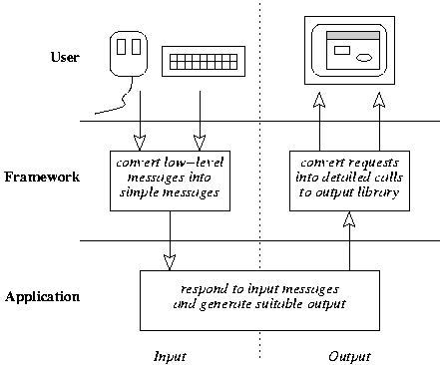
Typical Use of a Framework

Slide 9
Code Reuse
Application-specific code must be integrated into the framework
Traditionally, code reuse is based on using components defined in a library
Object-oriented reuse requires application classes to specialize hotspot classes in the framework

Slide 10
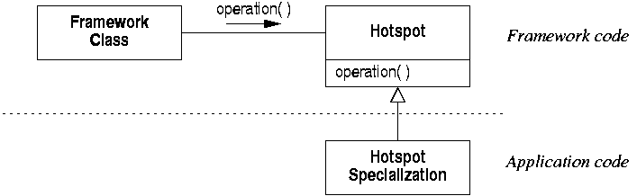
Hotspots
Application classes:
  specialize framework classes
  override relevant operations
  receive run-time messages from the framework

Slide 11
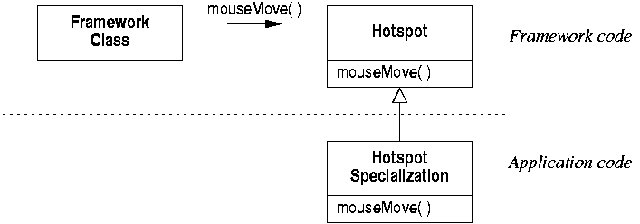
Detecting User Input
For example, the framework will detect when the user moves the mouse
The application code defines the response

Slide 12
Callbacks
Some operations need to implemented by both framework and application
For example, when updating a window:
  the framework can draw borders etc
  the application must provide window content
Do this by providing a callback or hook function

Slide 13
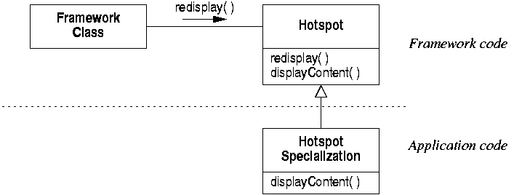
Window Updating
For example, the framework calls ‘redisplay’
  which in turn calls ‘displayContent’
  which is overridden by the application

Slide 14
Java AWT Framework
AWT is a simple Java framework for supporting window-based programming
  the user interface contains a number of components of various sorts
  listeners detect various events of interest
  listeners can be associated with the components that must respond to the events
The structure of the framework can be documented using UML

Slide 15
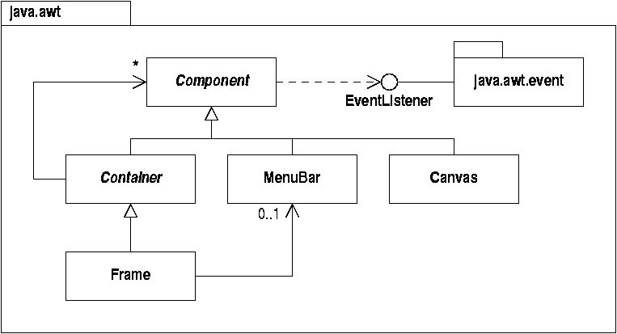
(Some of) AWT in UML

Slide 16
Implementing the Booking System
We can use AWT for the booking system by:
  deriving the main application window class from ‘Frame’
  deriving the user interface class from 'Canvas’
These relationships can be documented in UML

Slide 17
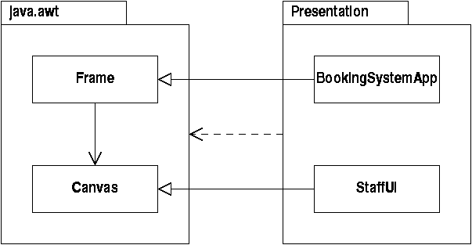
Documenting Framework Usage

Slide 18
Code Generation
Once the overall structure has been defined, individual model elements can be implemented
This can be made a rule-based process
  which can therefore be supported by code generation tools
But many alternative strategies are possible

Slide 19
Implementing Classes
Basic mapping:
  a class (in UML) is implemented by a class (in Java, C++ etc)
  attributes are implemented by fields
  operations are implemented by methods
There may be language specific issues
  eg the implementation of abstract classes

Slide 20
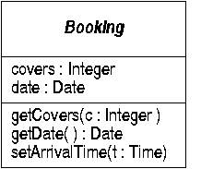
The Booking Class
public abstract class Booking {
  protected int covers ;
  protected Date date ;
  protected Booking(int c, Date d) {
    covers = c ; Date = d ;
  }
  public Date getDate() { return date; }
  public void setArrivalTime(Time t) { }
  public void setCovers(int c) { covers = c; }
}

Slide 21
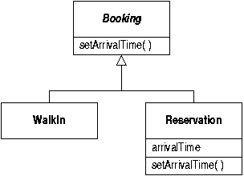
Generalization
Has similar properties to inheritance:
  subclass to superclass type conversions
  inheritance of attributes and operations

Slide 22
Implementation of Generalization
  public class WalkIn extends Booking
  {
    public WalkIn( ... ) { ... }
    public class Reservation extends Booking
    {
      Time arrivalTime ;
      public Reservation( ... ) { ... }
      public void setArrivalTime( Time t ) {
      arrivalTime = t ;
    }
  }

Slide 23

Class Multiplicity
By default, any number of class instances can be created
Sometimes this needs to be restricted
  eg use Singleton pattern to ensure there’s only one instance of ‘BookingSystem’
Use class multiplicity to define permitted number of instances:

Slide 24
Singleton Pattern
  public class BookingSystem
  {
    // Single instance stored and accessed
    // via 'getInstance' method
    private static BookingSystem uniqueInstance ;
    public static BookingSystem getInstance() {
      if (uniqueInstance == null) {
      uniqueInstance = new BookingSystem() ;
      }
      return uniqueInstance ;
    }
    // Private constructor to prevent creation of other instances
    private BookingSystem( ) { ... }
  }

Slide 25
Implementing Associations
Links can become references (pointers):
  they record the location and identity (address) of the linked object
  they allow messages to be passed
Associations can be implemented by defining suitable reference fields

Slide 26
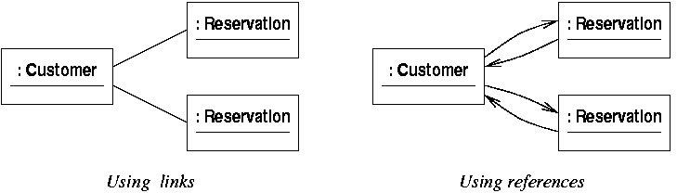
Bidirectionality
Two references implement a link fully
  messages can then be passed in both directions

Slide 27

Unidirectional Implementation
Often only need to implement an association in the direction of navigability:
public class Reservation {
private Customer customer ;
public Reservation( Customer c ) {
customer = c ;
}
}

Slide 28
Multiplicity
The exact multiplicity of an association may need to be checked at run-time
  every reservation should be linked to exactly one customer
  but the reservation could hold a null reference
    public Reservation( Customer c ) {
      if ( c == null ) { /* throw NullCustomerException */ }
      customer = c ;
    }

Slide 29

Implementing 'many'
A multiplicity greater than 1 requires a data structure to hold the references
public class BookingSystem {
private Vector current = new Vector( ) ;
public void addBooking( Booking b ) {
current.addElement(b);
}
}

Slide 30
Implementing Operations
Operations are implemented as methods
Use sequence diagrams containing the corresponding messages to work out implementation of an operation
If a statechart exists, it can be used to structure the implementation of a class's operations

Slide 31
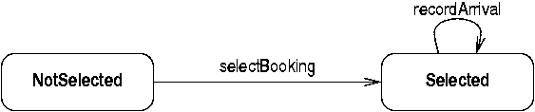
Implementing Statecharts
Statecharts describe the dynamic behaviour of objects
  this can be reflected in the class's operations
For example, for the initial BookingSystem statechart:

Slide 32
Implementing States
Define states as constants:
  public class BookingSystem
  {
    final static int NotSelected = 0 ;
    final static int Selected = 1 ;
    int state ;
    BookingSystem( ) {
      state = NotSelected ;
    }
  }

Slide 33
State-dependent Behaviour
Check current state in each operation:
  public void operation( ) {
    switch (state) {
      case NotSelected:
        // Specific actions for 'Not Selected' state
        break ;
      case Selected:
        // Specific actions for 'Selected' state
        break;
    }
  }

